Slide 1
BUSINESS START-UP 101
November 16, 2014

Slide 2
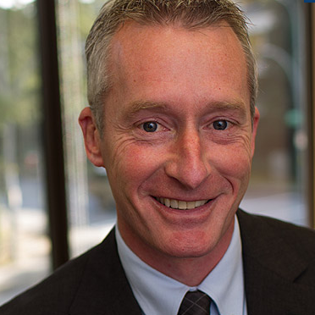
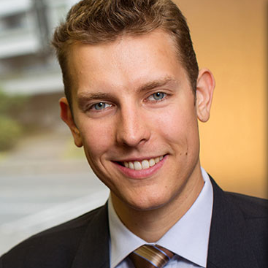
INTRODUCTION
ERIC SCHROTER PARTNER
BRANDON HASTINGS ARTICLED STUDENT

Slide 3
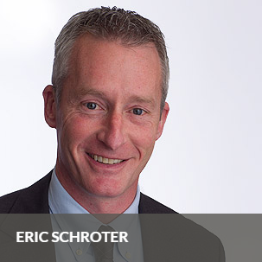
BIO
Business
Corporations
Tax Structures
Reorganizations
Succession Planning
Shareholders Agreements
Real Estate
Wills
Trusts
Estate Planning
Probate and Estate Administration

Slide 4
KEY CONSIDERATIONS
Level of Complexity
Tax Implications
Estate and Succession Planning Options
Cost
Liability

Slide 5
Sole Proprietorship Partnership Corporation
Basic Business Structures

Slide 6
Sole Proprietorship
Pros
Simple
Write-off losses
Low setup cost
Cons
Unlimited liability
Less sophisticated
Higher tax rate
Individual
Business

Slide 7
Partnership
Pros
Simple
Flow-through of revenue
Cons
All partners personally liable
More difficult financing
Fewer individual planning options
Written partnership agreement advisable
but rarely done
Individual
Individual
Partnership
Business

Slide 8
Corporation
Pros
Limited liability
Universally recognized
Continuing existence
Tax advantages
Articles govern shareholder relationships
Flexible
Cons
Losses trapped
Legal and accounting costs
Individual
Opco (Operating Company)

Slide 9
 | Sole Proprietor | Partnership | Corporation
Liability | Unlimited | Unlimited | Limited
Setup Cost | Low | Low-Med | High
Ongoing Cost | Low | Low | Med
Losses | Write-off | Write-off | Hold
Tax Rate | Higher | Higher | Lower
Financing Ease | Easier | Difficult | Easy

Slide 10
Holding Companies Trusts
Sophisticated Business Structures

Slide 11
Holding Companies
Individual
100%
Holdco (Holding Company)
100%
Opco

Slide 12
Holdco Advantages
Creditor-proof Opco
Separate Opcos for Projects
Tangible Assets
IP
Cash
Holdco
Holdco
100%
Work in Progress
Accounts Receivable
Opco
Opco
Opco
Opco

Slide 13
Shareholder Planning with Companies
Individual
Individual
Individual
Holdco₁
Holdco₂
Holdco₃
1/3
1/3
1/3
Opco

Slide 14
Family Trust
Trustee (Administers Trust)
Settlor (Gifts Initial Property)
Not a legal entity
Contractual arrangement b/w Settlor and Trustee
Trustee holds property on behalf of beneficiaries in accordance with trust agreement
Trust
Beneficiaries
Property

Slide 15
Trust Mechanisms
Trust may hold shares in opco
Trust may hold shares in holdco
Trustee
Trustee
Trust
Trust
Beneficiaries
Beneficiaries
100%
100%
Opco
Holdco
100%
Opco

Slide 16
Trust may hold shares in Opco and Investco
Trustee
Investco
Trust
100%
Beneficiaries
Family Members
100%
Opco

Slide 17
Summary: Advantages of Trusts
Tax Planning
Used to income split with family
Note: Kiddie Tax
Used to multiply capital gains exemption
Estate and Succession Planning
Tax-free transfer to beneficiaries
Delay succession decisions
Avoid Wills Variation
Maintain Confidentiality
Control of the Company
No requirements re:
Votes
Profit sharing
Information/Audit
Flexibility
Add/delete beneficiaries
Successor trusts
Discretionary and fixed terms

Slide 18
Personal Service Businesses

Slide 19
What is a “Personal Service Business”?
Specified Shareholder
3rd party purchaser (not “associated” with the Corp.)
Contract for Services
Corporation
This or a “related” person provides services and it is “reasonable to regard” the person as an “employee” of the third party if you ignore the corporation
A “specified shareholder” is defined in subsection 248(1) of the Income Tax Act, RSC 1985, c 1, to mean ownership, directly or indirectly, of 10% or more of any class of the issued shares of the corporation

Slide 20
Personal Services Businesses
EXCEPT:
a corporation in the service business,
where the “specified shareholder” or a “related” individual performs the services, and
(the “But-For Test”) if you were to ignore the corporation, the “specified shareholder” or “related” individual would seem like an employee
Corporation
5+ Employees

Slide 21
Drawbacks of a “Personal Service Business”
Categories of expenses constrained
Tax Rate = 39%, instead of low corporate rate
May defer only 6.8% of tax, but will pay 11.2% penalty on distribution to shareholder

Slide 22
Four-in-one Test
Who has Control?
Who has Ownership of Tools?
Who Gains Rewards of Profits?
Who Bears Risks of Loss?
Is this a “true” business?

Slide 23
Tax Planning Techniques

Slide 24
Small Business Deduction
Deduction Application
Active Business Income
Applies to Canadian-Controlled Private Corporations (CCPC)
Claim on Canada-source Active Business Income (ABI)
Tax rate on CCPC’s ABI
11% federal
13.5% combined with BC
Limited to $500,000
Share $500,000 limit with associated companies
Any business, adventure, or concern in the nature of trade, excluding income from businesses that:
Have fewer than 6 full-time employees, and
Derive income from:
Property (including interest, dividends, royalties, and rent – i.e. a “specified investment business”, or
Is a Personal Service Business (as discussed)

Slide 25
Dividend Sprinkling
Multiple classes of non-voting common shares
Thin Shares
Redeemable by corporation at nominal value
Kiddie tax prevents income splitting with family members under 18 years of age
Family trust offers most flexibility

Slide 26
Capital Gains Exemption
Shares of Qualified Small Business Corporations (QSBCs) qualify for the exemption
QSBCs are:
CCPCs which use 90% of their assets in an Active Business in Canada
Conditions to be met up to 2 years before sale:
Remove/transfer non-Active Business assets
Access to $800,000 capital gains tax exemption
Capital gains exemption to increase with cost-of-living

Slide 27
Capital Gains Exemption Example
Shares initially issued for $1.00/share
Sale of Shares for $2.5M
$2.4M ($800,000 x 3) exempt
Shareholder
Shareholder
Shareholder
Opco

Slide 28
Closing Remarks
Plan in stages to reduce cost
Seek professional advice

Slide 29
Thank you Questions Welcome
+1 (604) 273-8481
eschroter@cfmrlaw.com | Eric Schroter, Partner
dloong@cfmrlaw.com | Dolly Loong, Legal Assistant

